Slide 1
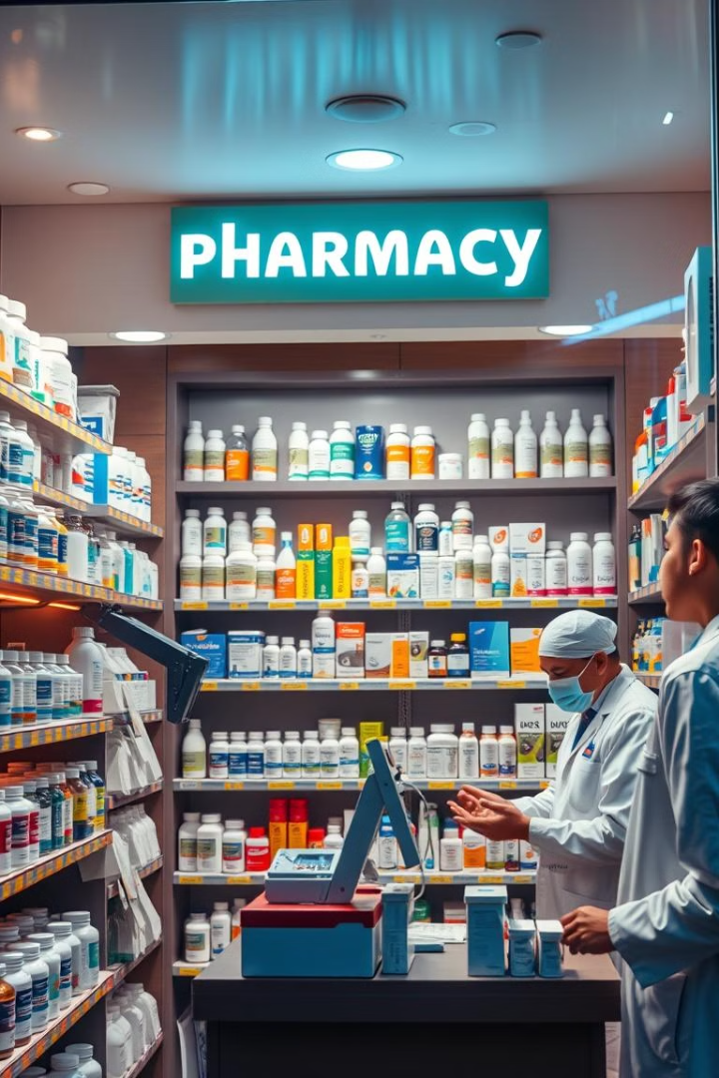

Kurla Medical: Your Online Pharmacy
Kurla Medical is a user-friendly online pharmacy platform that offers a wide selection of medicines, medical devices, and other healthcare products.
by Bhavik Prajapati

Slide 2

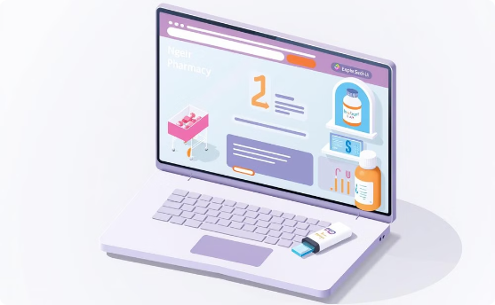
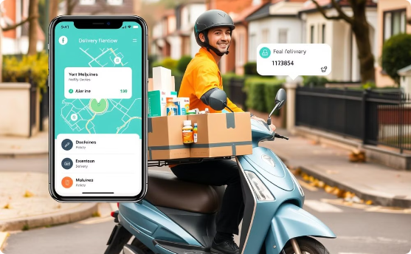
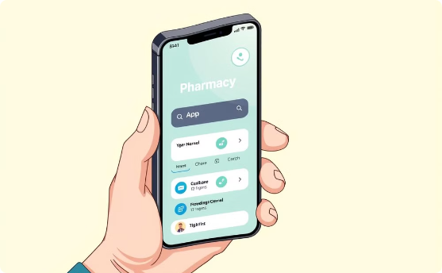
Introduction: A Modern Pharmacy Solution
Easy Ordering
Home Delivery
User-Friendly Interface
Customers can easily browse and order medicines, medical devices, and healthcare products online.
Products are delivered directly to customers' homes, saving time and effort.
The website is designed to be intuitive and easy to navigate.

Slide 3

Technology Stack: Building a Robust Platform
Frontend
HTML, CSS, JavaScript
Backend (Future Plan)
Full-stack development, Git/GitHub version control
IDE
Visual Studio Code
Product Management
JSON file for dynamic product listing

Slide 4

Search Bar Feature: Finding What You Need
The search bar is a key feature that allows users to quickly and easily find the specific medicines or products they need.
1
Quick and Efficient
2
Dynamic Results
3
Enhanced User Experience
Users can type the name or keywords of a product and get instant results.
The search bar displays relevant product details dynamically based on user input.
Users can easily access desired products without navigating through multiple pages.

Slide 5

Shopping Cart Feature: A Smooth Checkout Experience
The shopping cart feature allows customers to add products to their cart, review their selections, and proceed to checkout.
Add to Cart
Cart Overview
Checkout
Users can easily add selected items to their cart with a simple click.
The cart displays a list of items, quantities, and a running total price.
Users can review their selections, modify quantities, and proceed to checkout securely.

Slide 6




Feedback Form: Gathering Valuable Insights
The feedback form is an essential tool for collecting valuable customer feedback and suggestions for improvement.
Customer Feedback
Queries and Concerns
Improved User Experience
Users can share their experiences, suggestions, and any concerns.
Users can submit questions about products, services, or any other inquiries.
Feedback helps to enhance the website and provide a better experience for all users.

Slide 7
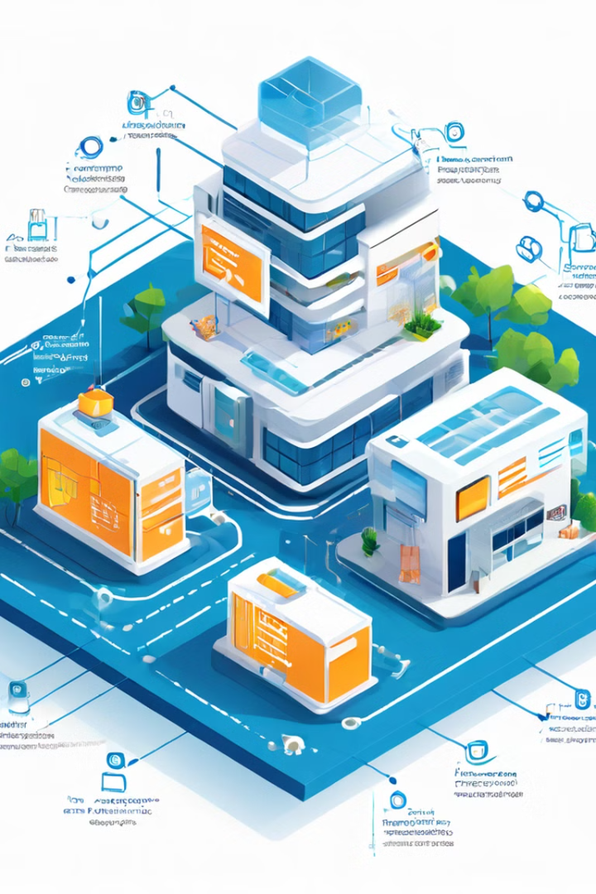
Future Plans: Full-Stack Integration
Kurla Medical will transition to a full-stack development approach to enable dynamic data management and advanced backend features.
1
Dynamic Product Management
Real-time updates on product availability, pricing, and inventory.
2
Order Tracking
Customers can track the status of their orders in real-time.
3
Secure User Authentication
Protecting user data and ensuring secure transactions.
4
Payment Gateways Integration
Seamless online transactions through integrated payment options.

Slide 8
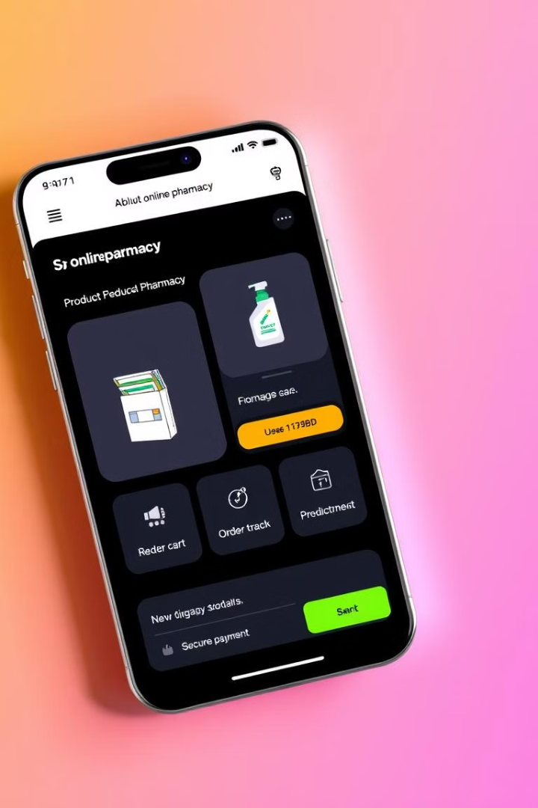




Future Plans: Mobile App Development
Kurla Medical aims to develop a mobile application to enhance user convenience and accessibility.
Seamless Browsing
Users can easily browse and order products on their smartphones.
Order Management
Users can manage their orders, track delivery status, and access order history.
Push Notifications
Real-time updates on order status, promotions, and new product arrivals.
Improved User Experience
Providing a convenient and user-friendly experience on mobile devices.

